Slide 1



Benign overfitting in two-layer convolutional neural networks
Author(s): Y Cao, Z Chen, M Belkin, Q Gu
Presenter: Faiza Anan Noor

Slide 2
TABLE OF CONTENTS
01
02
03
04
05
Introduction
Here, we learn about the paper
Fundamentals
Here, we learn about some fundamental ideas behind the paper
Working Mechanism
Here, the Working Mechanism is depicted
Results
The results are given
Challenges, Future Direction
The challenges faced and future directions plausible are given

Slide 3
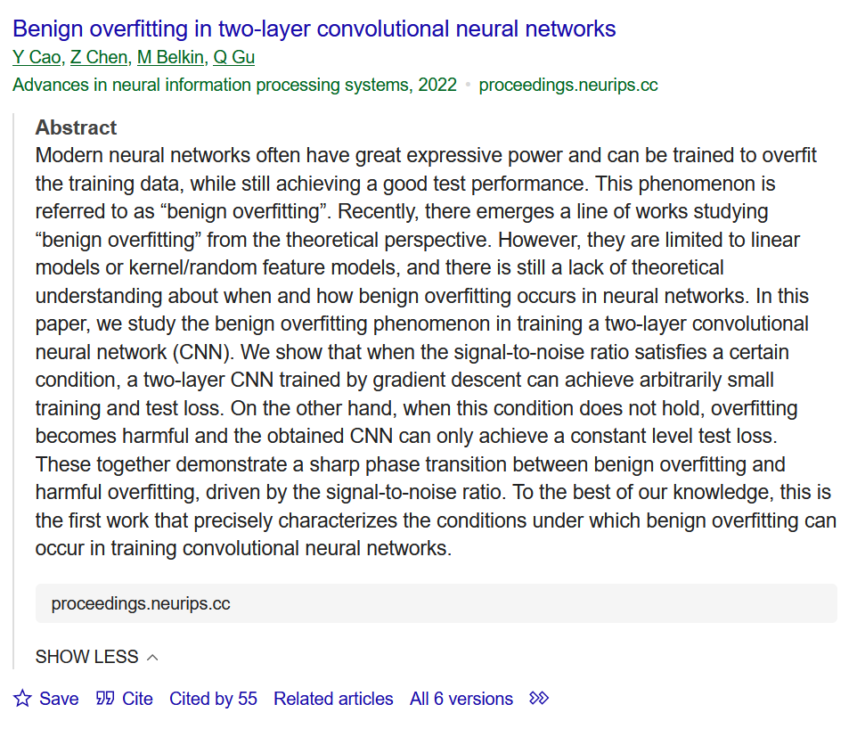
Introduction

Slide 4


Main Idea
Focus: Benign overfitting phenomenon in training a two-layer convolutional neural network (CNN).
When the signal-to-noise ratio satisfies a certain condition, a two-layer CNN trained by gradient descent can achieve arbitrarily small training and test loss
When this condition does not hold, overfitting becomes harmful and the obtained CNN can only achieve constant level test loss.

Slide 5
Main Idea
Focus: The process of signal learning and noise memorization in the training of a two-layer CNN using a signal-noise decomposition.
A phase transition of the population loss with regard to sample size, signal intensity, noise level, and dimension is shown, and they accurately specify the parameters under which the CNN will primarily focus on learning signals or memorizing noises
They establish population loss bounds of overfitted CNN models trained by gradient descent, and theoretically demonstrate that benign overfitting can occur in learning over-parameterized neural networks.

Slide 6
Findings: Under certain conditions on the signal-to-noise ratio, CNN models trained by gradient descent will prioritize learning the signal over memorizing the noise, and thus achieving both small training and test losses.
The first work that precisely characterizes the conditions under which benign overfitting can occur in training convolutional neural networks
•

Slide 7
Parallel work (Frei et al., 2022):
Fully-connected two-layer neural networks
Smoothed leaky ReLU activation to study learning log-Concave mixed data with label flip noise.
When the label flip noise is zero, their risk bound coincides with the risk bound for linear models reported in Cao et al. (2021).
Does not show the phase transition between harmful and benign overfitting;
Focuses on upper bounding the risk. In contrast to (Frei et al., 2022),
•

Slide 8
Main concentration on CNNs and examine an alternative data model to more accurately represent the characteristics of image classification issues.
They show a distinct phase transition between beneficial and detrimental overfitting and give both positive and negative findings under various SNR regimes.

Slide 9
They also establish a negative result showing that when the conditions on the signal-to-noise ratio do not hold, then the overfitted CNN model will achieve at least a constant population loss. This result, together with their upper bound result, reveals an interesting phase transition between benign overfitting and harmful overfitting.
Paper: https://arxiv.org/abs/2202.06526
•

Slide 10

Convolutional neural network is a regularized type of feed-forward neural network that learns feature engineering by itself via filters optimization.
CNNs automatically learn hierarchical representations of features in images. Through convolutional and pooling layers, they detect patterns, textures, edges, and more complex features.
Convolutional
neural network

Slide 11
02. Fundamentals
Modern deep learning models often consist of a huge number of model parameters, which is more than the number of training data points and therefore over-parameterized. These over-parameterized
Models can be trained to overfit the training data (achieving a close to 100% training accuracy), while still making accurate prediction on the unseen test data.
Benign Overfitting:

Slide 12
02. Fundamentals
When a Convolutional Neural Network (CNN) begins to perform marginally better on training data but not noticeably worse on validation or test data, this is referred to as benign overfitting.
"benign" as it does not negatively impact the model's capacity to generalize to new data.
Benign Overfitting:

Slide 13
The Ratio between the Signal and Noise in any particular medium is called SNR.
Often expressed in decibels.
A ratio higher than 1:1 indicates more signal than noise
Signal to Noise Ratio(SNR)

Slide 14
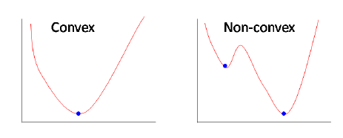
Such a problem may have multiple feasible regions and multiple locally optimal points within each region.
For example, exchanging intermediate neurons • This symmetry means they can't be convex.
Non convexity

Slide 15

They provided algorithmic analysis for learning two-layer convolutional neural networks (CNNs) .
Filters are applied to the two patches
x1 and x2 separately,
Second layer parameters being fixed as: (+1/ms and −1/ms)
Polynomial ReLU activation function:
σ(z) = max{0, z} q ,
where q > 2 is a hyperparameter.

Slide 16
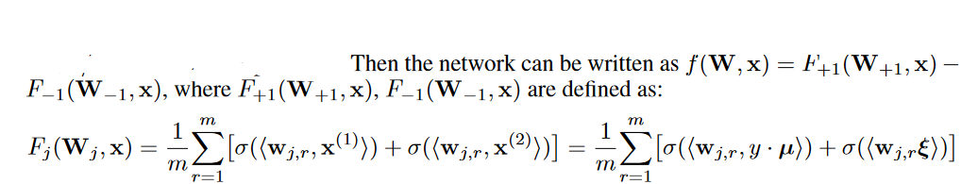
Classification: They focused on binary classification.
Noise: Generated from the Gaussian distribution N(0, σ2).

Slide 17
Settings:
Input data: Consist of label dependent signals and label independent noises
Signal-noise decomposition of the CNN filters to precisely characterize the signal learning and noise memorization processes during neural network training.
They converted the neural network learning into a discrete dynamical system of the coefficients from the decomposition,
Perform a two-stage analysis that decouples the complicated relation among the coefficients

Slide 18
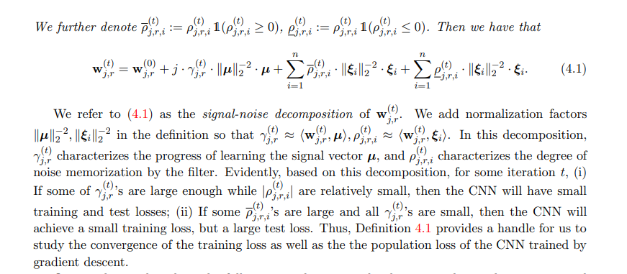
Introduced new proof technique namely signal-noise decomposition, which decomposes the convolutional filters into a linear combination of initial filters, the signal vectors and the noise vectors.

Slide 19
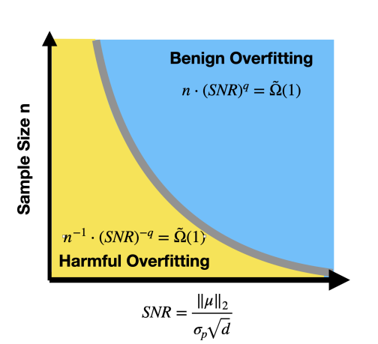
04. PREDICTED RESULTS
Illustration of the phase transition between benign and harmful overfitting. The blue region represents the setting under which the overfitted CNN trained by gradient descent is guaranteed to have small population loss, and the yellow region represents the setting under which the population loss is guaranteed to be of constant order. The slim gray band region is the setting where the population loss is not well characterized.

Slide 20
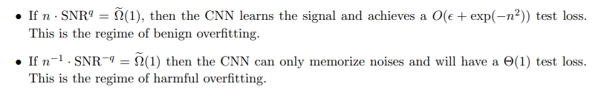
Their result not only demonstrates that benign overfitting can occur in learning two-layer neural networks, but also gives precise conditions under which the overfitted CNN trained by gradient descent can achieve small population loss.
Notes:
N sample size. Omega: lower bound

Slide 21
Intuitively, the initial neural network weights are small enough so that the neural network at initialization has constant level cross-entropy loss derivatives on all the training data.
Based on the result in the first stage, they then proceed to the second stage of the training process where the loss derivatives are no longer at a constant level and show that the training loss can be optimized to be arbitrarily small and meanwhile, the scale differences shown in the first learning stage remain the same throughout the training process
This enables them to analyze the non-convex optimization problem, and bound the population loss of the CNN trained by gradient descent. Proof technique is of independent interest and can potentially be applied to deep neural networks.

Slide 22

05. challenges
Challenge:
Nonconvexity of the training objective function LS(W). Nonconvexity has introduced new challenges in the study of benign overfitting particularly
Reason:
Their goal is to show the convergence of the training loss and population loss in the over-parameterized setting, which requires a precise algorithmic analysis of the learning problem
Notes:
study of benign overfitting particularly because our goal is not only to show the convergence of the training loss and population loss in the over-parameterized setting, which requires a precise algorithmic analysis of the learning problem

Slide 23
Future plans: To extend benign underfitting to other data models
Their findings conceptually validates the possibility of benign overfitting during neural network training.
Studying the benign overfitting phenomena of neural networks in the context of learning other data models is a crucial area of future research. Furthermore, it is imperative to extend our study to deep convolutional neural networks.

Slide 24
Discussion points
Some common solutions for overfitting?
1)
How does benign overfitting differ from underfitting?
2)
Why should benign overfitting be an issue if it causes slight generalization problems?
3)
Notes:
Generalization Concerns: While benign overfitting might not significantly affect model performance on validation or test data, it still indicates that the model is learning specific features or noise present only in the training set. This might limit its ability to generalize well to new, unseen data that might not contain those specific patterns.
Potential Escalation: Benign overfitting, if left unchecked or if the model complexity increases, could potentially escalate into more severe overfitting. As the model continues to learn intricacies of the training data, it might eventually lose its ability to generalize effectively.
Model Interpretability: Models exhibiting benign overfitting might become more complex and harder to interpret. They could be relying on features that are idiosyncratic to the training data but are not necessarily relevant in a broader context, making it difficult to understand the decision-making process of the model.
Resource Allocation: Training a model that exhibits benign overfitting still requires computational resources and time. If the overfitting is not addressed, these resources might not be efficiently utilized, especially if the model's performance doesn't improve significantly on new data.
https://towardsdatascience.com/8-simple-techniques-to-prevent-overfitting-4d443da2ef7d
1. Hold-out 2. Cross-validation 3. Data augmentation 4. Feature selection 5. L1 / L2 regularization 6. Remove layers / number of units per layer 7. Dropout 8. Early stopping

Slide 25
THANKS!
Any questions?

Slide 26
References
CAO, Y., GU, Q. and BELKIN, M. (2021). Risk bounds for over-parameterized maximum margin classification on sub-gaussian mixtures. Advances in Neural Information Processing Systems 34.
FREI, S., CHATTERJI, N. S. and BARTLETT, P. L. (2022). Benign overfitting without linearity: Neural network classifiers trained by gradient descent for noisy linear data. arXiv preprint arXiv:2202.05928.
Cao, Y., Chen, Z., Belkin, M., & Gu, Q. (2022). Benign overfitting in two-layer convolutional neural networks. Advances in neural information processing systems, 35, 25237-25250.

